Slide 1

UML - Model

Slide 2
Page Model
Upper Frame 1
Upper Frame 2
Left Frame
Center Frame
Right Frame
Lower Frame

Slide 3
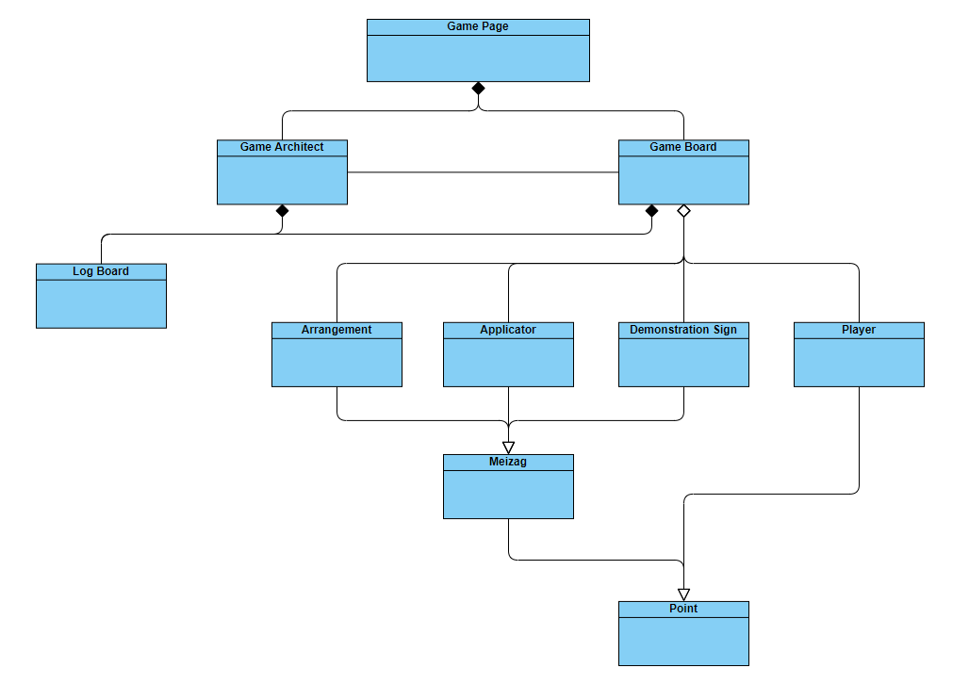
Class Tree

Slide 4

Class: Game Page
Attributes:
game_architect: Game_Architect
game_board: Game_Board
Methods:
(Nothing special)

Slide 5

Class: Game Architect
Attributes:
log_board: Log_Board
image_list_name: list
image_size: list
controlButtons: list
s1, s2: Style
5 X frames: Frame
5 X buttons: Button
4 X canvases: Canvas
1 X label: Label
Methods:
get_items()

Slide 6

Class: Game Board
Attributes:
active_players: int
position: int
items: tuple(Log_Board, list)
log_board: Log_Board
board_shape: Frame
Icon_size: list
Image_name: list
Image_player_name : list
list_of_Labels_board: list
list_of_Logic_board: list
list_of_players: list
list_of_images: list
list_of_player_images: list
Methods:
Empty_location_creator()
Is_in_board(x: int, y: int)
Is_empty(x: int, y: int)
Is_Entity(x: int, y: int, entity: object)
Update_Movement(player: Player, x: int, y: int, k: int, m: int)
WonCase(Who_won: int, position1: int, position2: int, Remove_player: Player, player: Player, x: int, y: int, k: int, m: int
Events:
RestartGame()
Onleft()
Onright()
Onup()
Ondown()

Slide 7

Class: Log Board
Attributes:
Super: Point
lines_amount: int
log: list
labels: list
Methods:
Update_log(meesage: str)
WelcomeMessage()
Reset_Log()

Slide 8

Class: Player
Attributes:
Super: Point
position: int
list_of_Meizags: list
Methods:
Stronger(player: Player)
addMeizag(Meizag: object)
add_list_of_Meizags(list_meizags: list)
get_list_of_Meizag()
get_position()
set_position(position: int)

Slide 9

Class: Barrier
Attributes:
Super: Point
Methods:
(Nothing special)

Slide 10

Class: Meizag
Attributes:
Super: Point
Methods:
(Nothing special)

Slide 11



Class: Arrangement
Class: Demonstration Sign
Class: Applicator
Attributes:
Super: Point
Methods:
__str__()
Attributes:
Super: Point
Methods:
__str__()
Attributes:
Super: Point
Methods:
__str__()

Slide 12
Class Tree
Game Page
Inheriting
Concludes
Game Architect
Game Board
Player
Log Board
Arrangement
Demonstration Sign
Applicator
Meizag
Point

